Slide 1
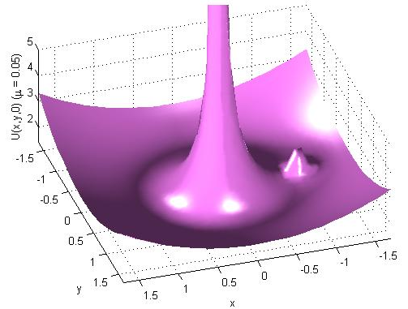

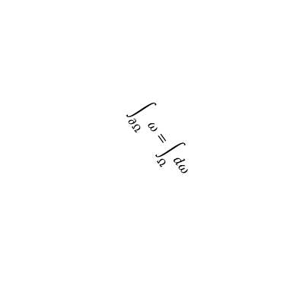
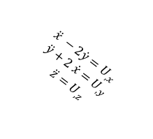

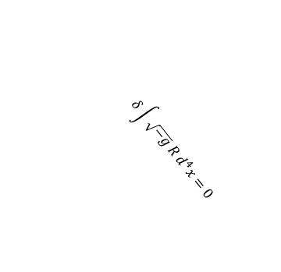
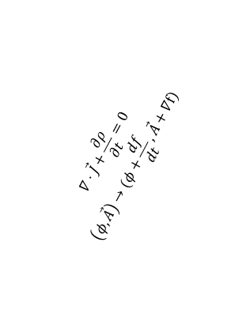
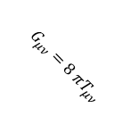
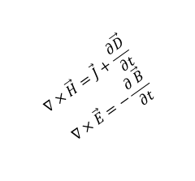
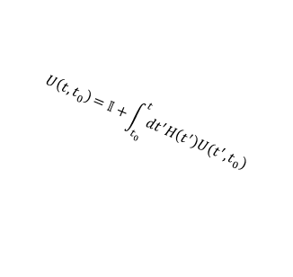

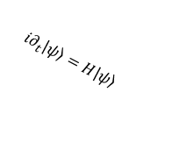
Under the Hood
$$\vec{N}$$
$$\hat{n}$$
$$∇⋅\vec{B}=0$$
$$∇⋅\vec{D}=ρ$$
interface
$$∇⋅\vec{J}+\frac{∂ρ}{∂t}=0$$
$$\left(φ,\vec{A}\right)→(φ+\frac{df}{dt},\vec{A}+∇f)$$
$$\ddot{x} −2\dot{y}=U_{,x}$$
$$\ddot{y}+2 \dot{x}=U_{,y}$$
$$\ddot{z}=U_{,z}$$
$$∇×\vec{H}=\vec{J}+\frac{∂\vec{D}}{∂t}$$
$$∇×\vec{E}=−\frac{∂ \vec{B}}{∂t}$$
Medium 1
$${i∂}_{t}\left|\left.ψ\right\rangle =H\right|\left.ψ\right\rangle$$
Medium 2
$$U\left(t,t_{0}\right)=𝕀+\int_{t_{0}}^{t}{dt^{′}H\left(t^{′}\right)U(t^{′},t_{0})}$$
$$G_{μν}=8 πT_{μν}$$
$$δ\int{\sqrt{−g} R d^{4}x=0}$$
$$\int_{∂Ω}{ω}=\int_{Ω}{dω}$$

Slide 2
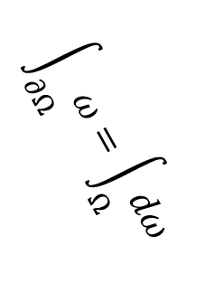
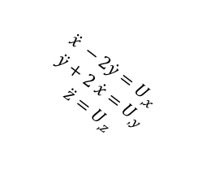
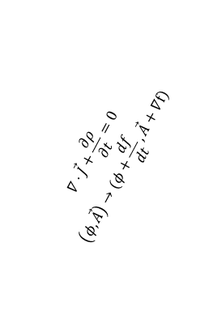
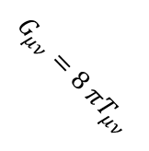
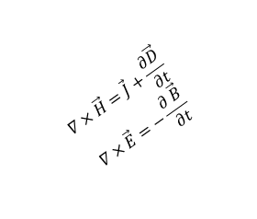
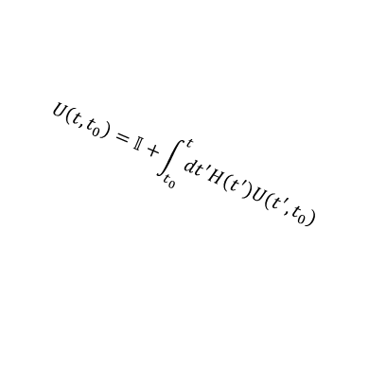

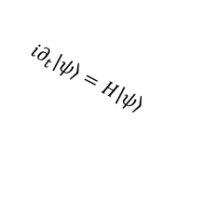
$$\vec{N}$$
$$\hat{n}$$
$$∇⋅\vec{B}=0$$
$$∇⋅\vec{D}=ρ$$
interface
$$∇⋅\vec{J}+\frac{∂ρ}{∂t}=0$$
$$\left(φ,\vec{A}\right)→(φ+\frac{df}{dt},\vec{A}+∇f)$$
$$\ddot{x} −2\dot{y}=U_{,x}$$
$$\ddot{y}+2 \dot{x}=U_{,y}$$
$$\ddot{z}=U_{,z}$$
$$∇×\vec{H}=\vec{J}+\frac{∂\vec{D}}{∂t}$$
$$∇×\vec{E}=−\frac{∂ \vec{B}}{∂t}$$
Medium 1
$${i∂}_{t}\left|\left.ψ\right\rangle =H\right|\left.ψ\right\rangle$$
Medium 2
$$U\left(t,t_{0}\right)=𝕀+\int_{t_{0}}^{t}{dt^{′}H\left(t^{′}\right)U(t^{′},t_{0})}$$
$$G_{μν}=8 πT_{μν}$$
$$δ\int{\sqrt{−g} R d^{4}x=0}$$
$$\int_{∂Ω}{ω}=\int_{Ω}{dω}$$

